Slide 1
Approximate Trajectory Queries Under the Fréchet Distance
Presented by
John Pfeifer
Research Student, School of IT
Contributors
Dr. Joachim Gudmundsson
Dr. Michael J. Horton
John Pfeifer

Slide 2
Quote
“Everything we hear is an opinion, not a fact. Everything we see is a perspective, not the truth.”
Marcus Aurelius, Roman Emperor, 121-180AD

Slide 3
Agenda
5-Minute Overview
Sample Dive
Drawbacks & New Questions

Slide 4
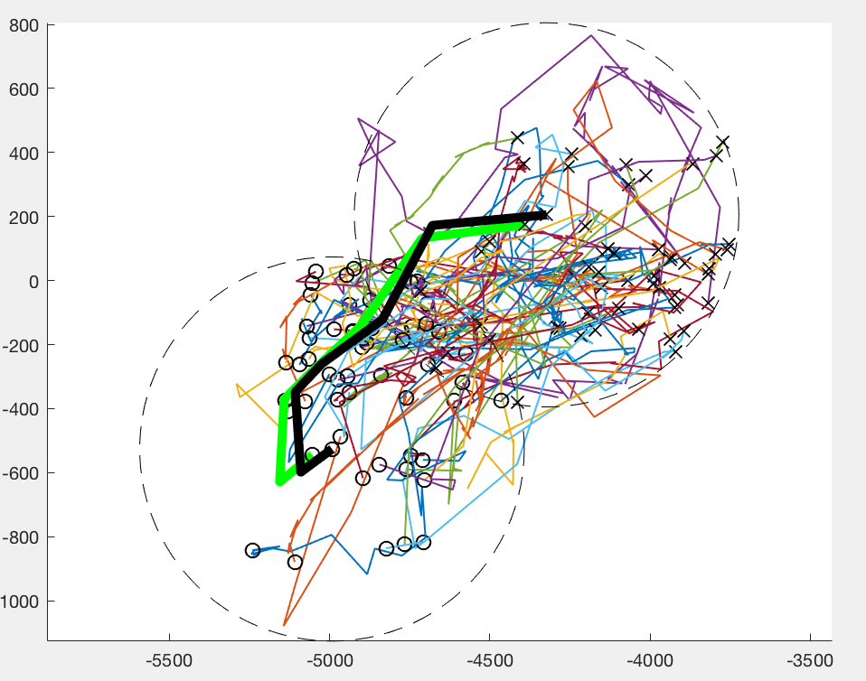
Our Research
We study data structures that support movement queries
More specifically:
Trajectories - the path an object takes as it moves through space & time
NN, kNN, and RNN queries
Use the Fréchet distance
Provides natural distance between two trajectories
But! It’s slow – quadratic runtime

Slide 5
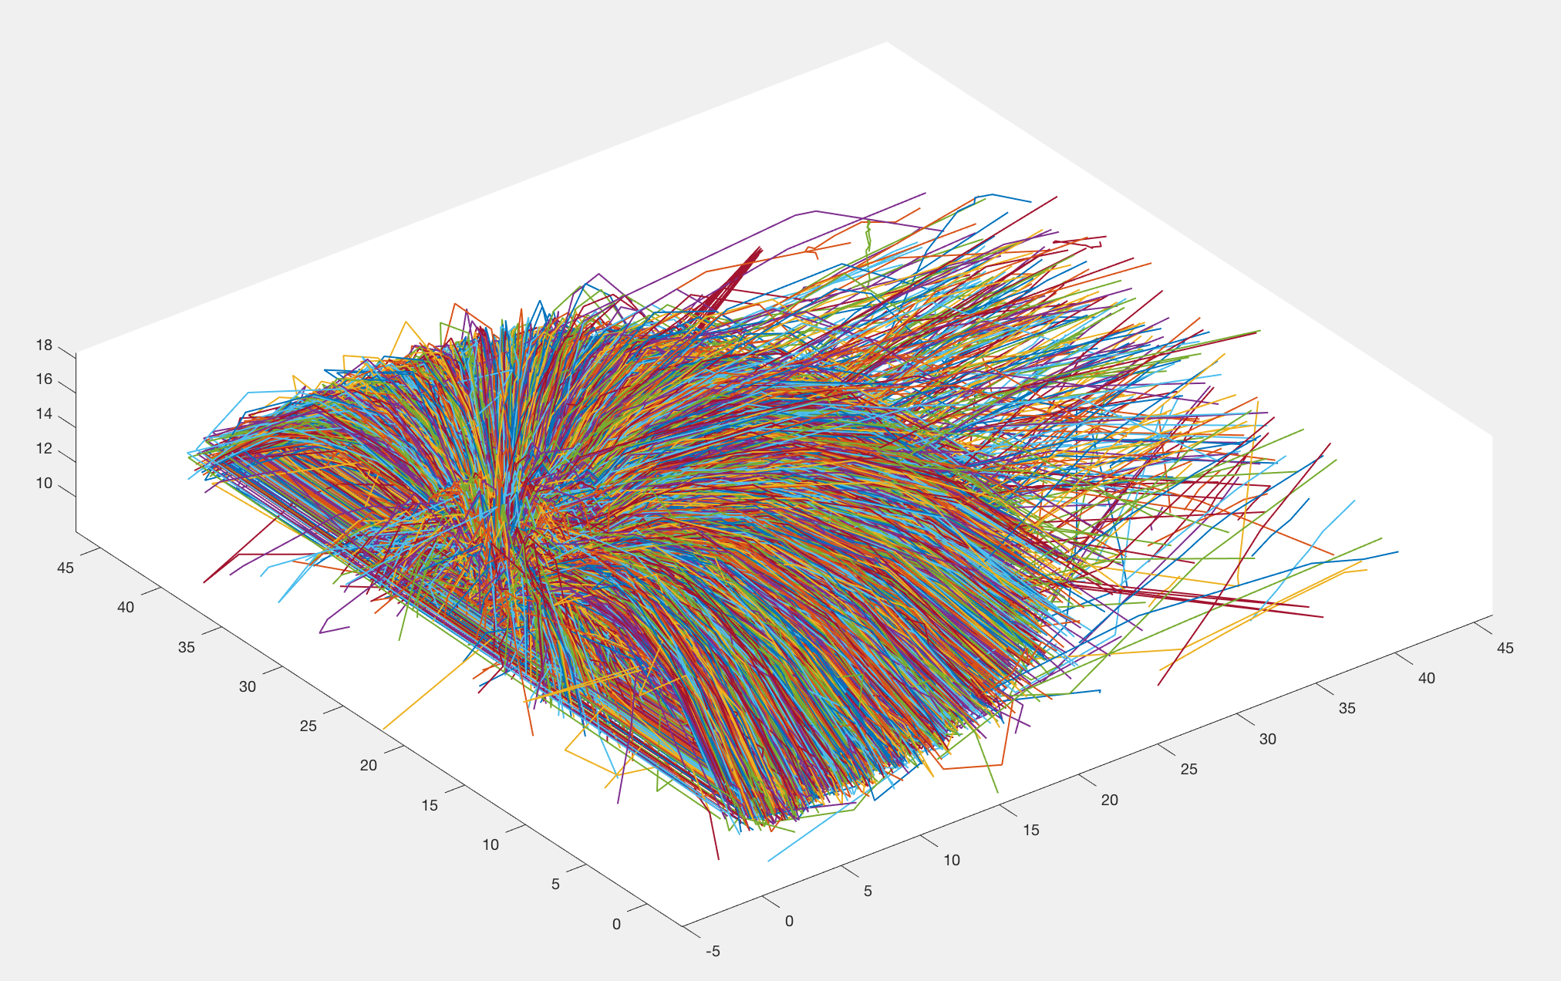
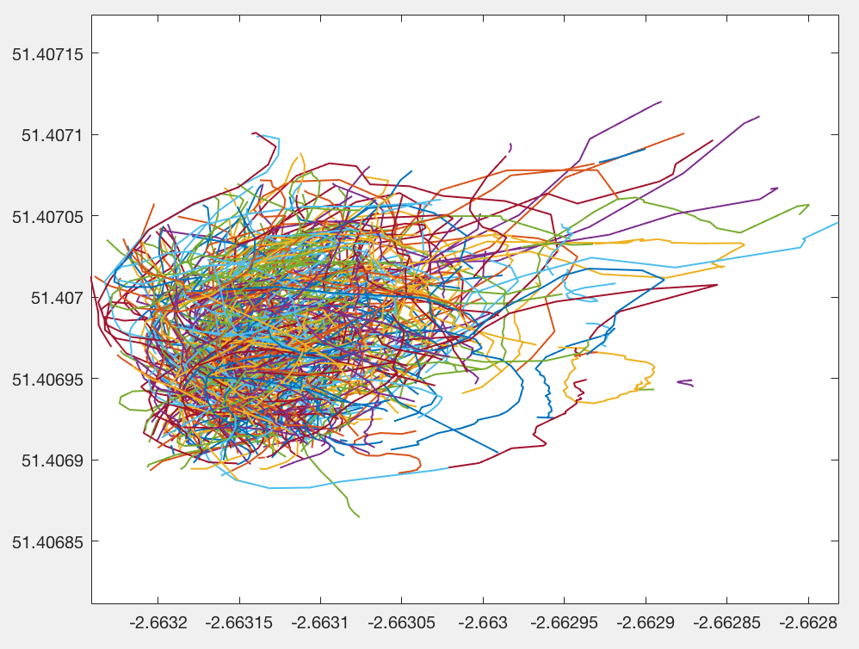
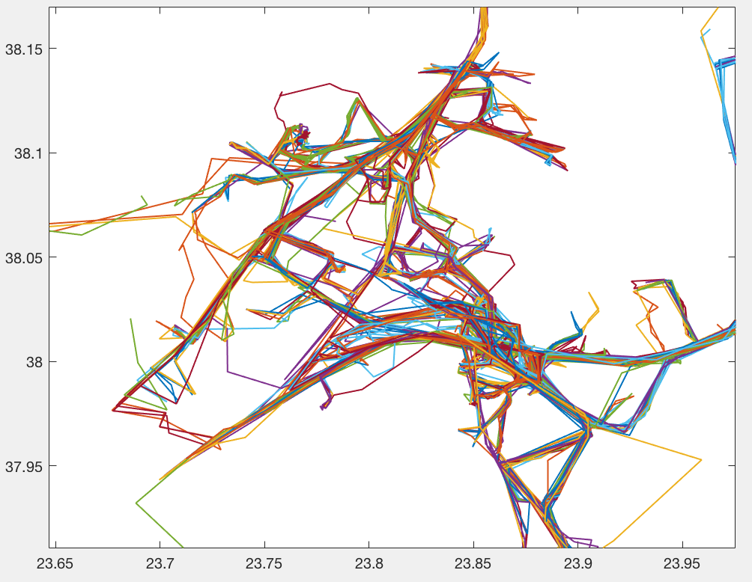
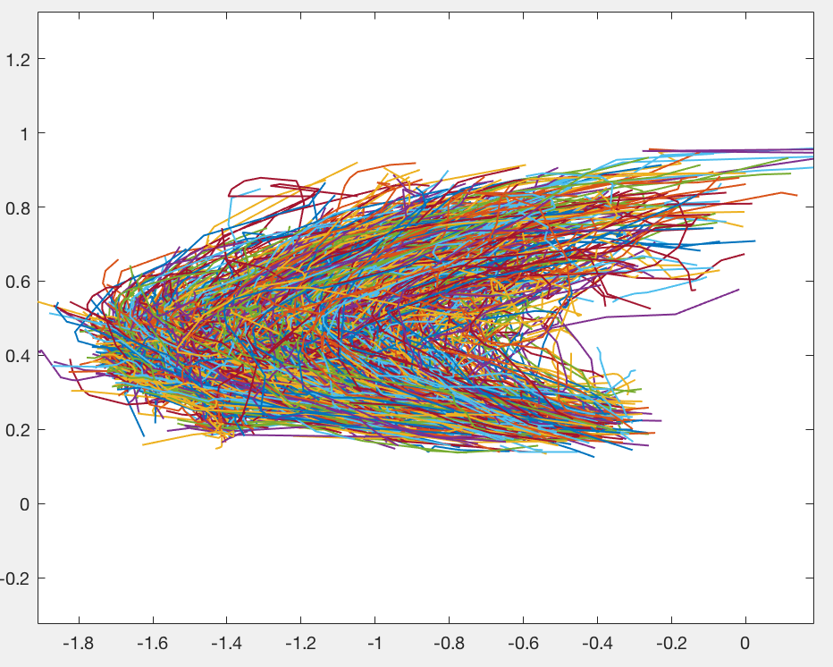
Motivation – Applications for NN Queries
Sports Analysis
Wildlife movement behavior
Vehicles
Atlantic Hurricane

Slide 6
Motivation - Gaps
Is there an efficient data structure that supports approximate Fréchet distance NN, kNN, RNN queries on trajectories?
Try and minimize quadratic Fréchet computations for query
Existing papers all contain at least one drawback:
Only supports one of NN, kNN, RNN [17,18,19]
Exponential build/query time (size of curves) [20,21,25]
Fairly large approximation bounds [21,24,25]
Others: straight lines only, Fréchet variant, constraints on curves [22,23,24,26]

Slide 7
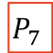
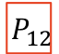
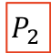
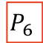
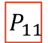
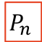

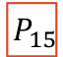

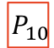

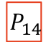

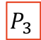
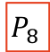

Our Contribution
New or improved upper/lower Fréchet bounds (linear)
New Cluster Centre Tree data structure
$$P_{7}$$
$$P_{12}$$
$$P_{5}$$
$$P_{6}$$
$$P_{8}$$
$$P_{9}$$
$$P_{10}$$
$$P_{11}$$
$$P_{13}$$
$$P_{14}$$
$$P_{15}$$
$$P_{n}$$
$$P_{1}$$
$$P_{2}$$
$$P_{3}$$
$$P_{4}$$

Slide 8
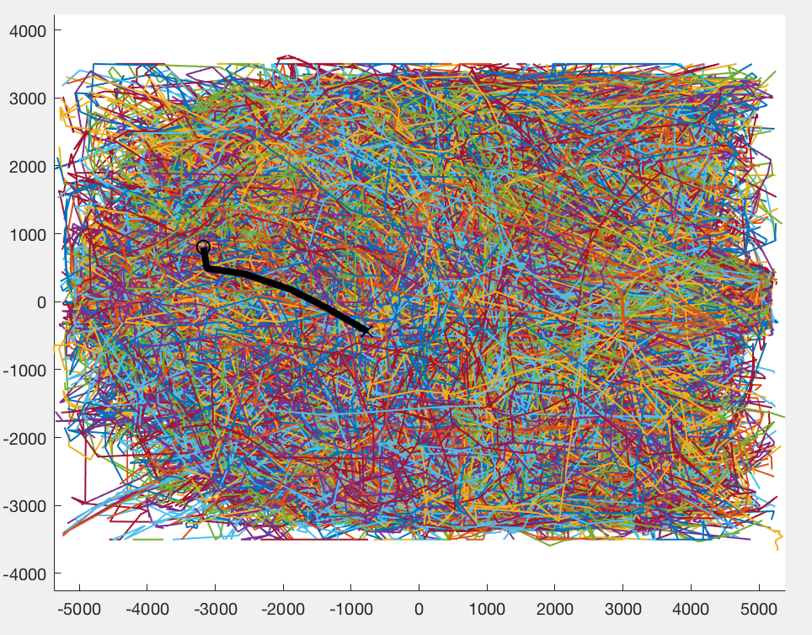
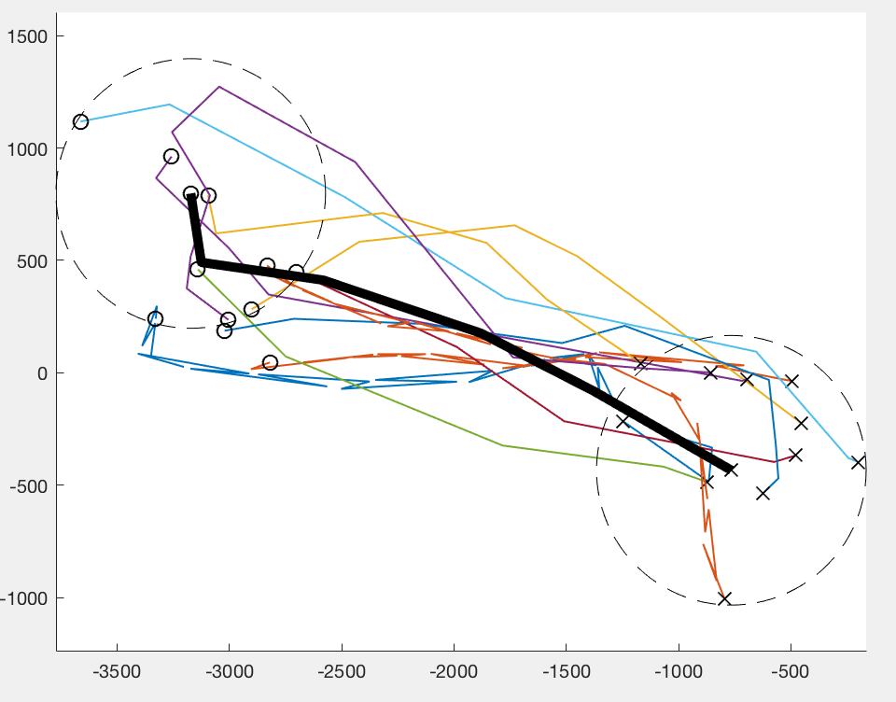
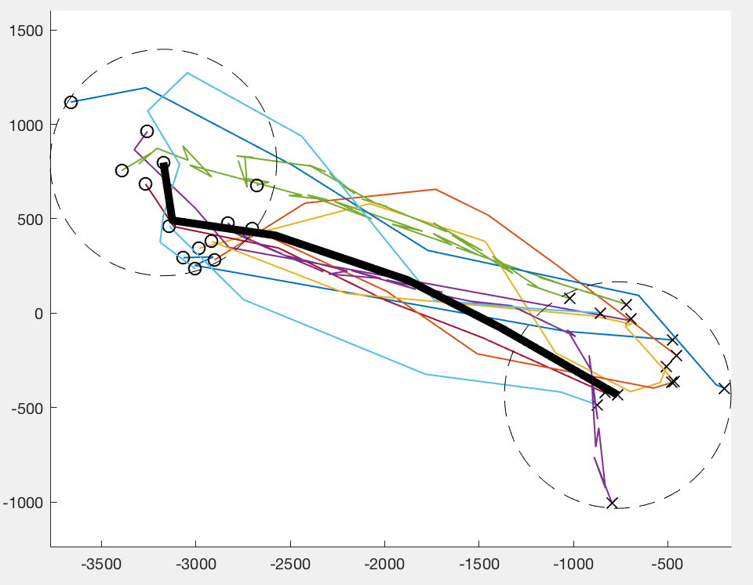
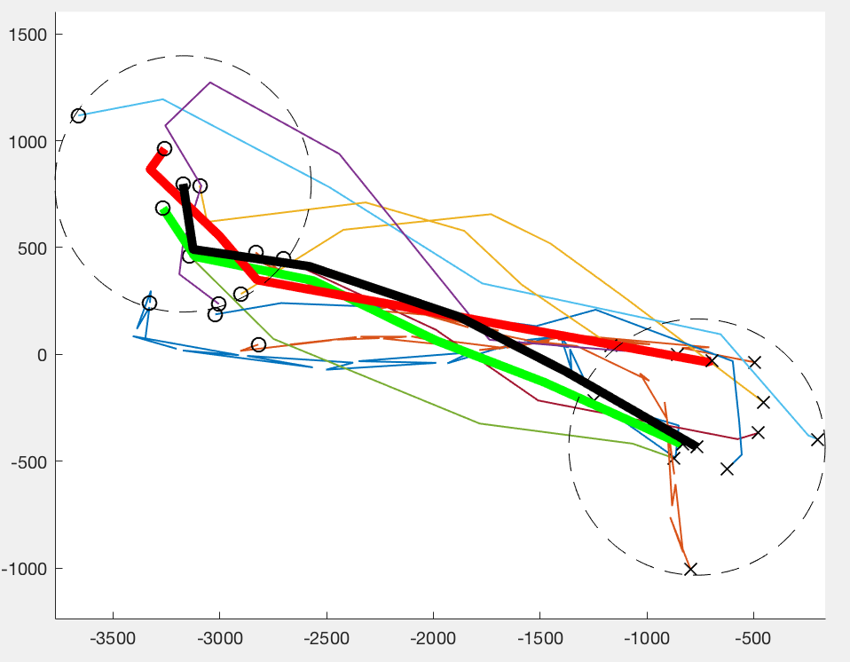
Our Contribution
Convert: Cluster Centre Tree or Cluster Centre Stamp, bounds
Select: bounds & maybe CFD & FDP computations
Prune: Cluster Centre Tree, bounds
→ 14
→ 11
→ 1
18034
Trajectories

Slide 9
Relatively Large Datasets
Tens of thousands of curves
Each curve can contain thousands of vertices

Slide 10
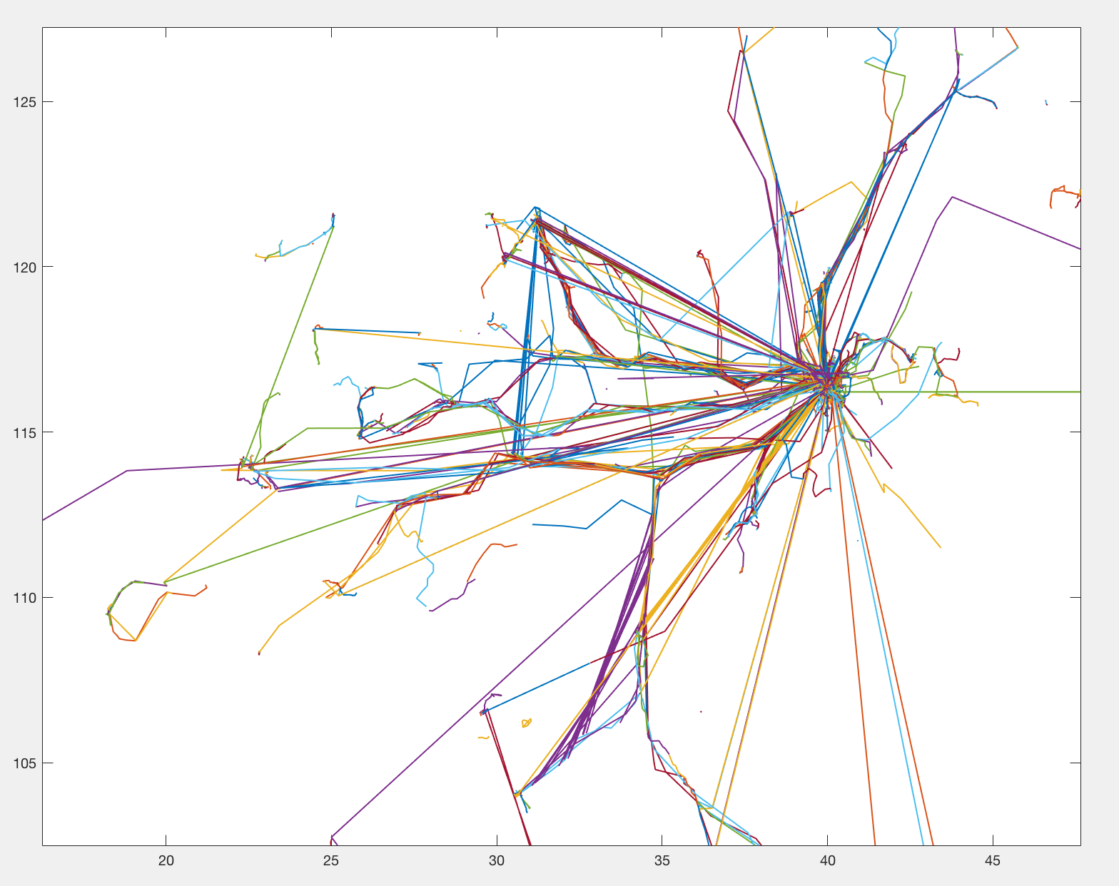
18670 People trajectories

Slide 11
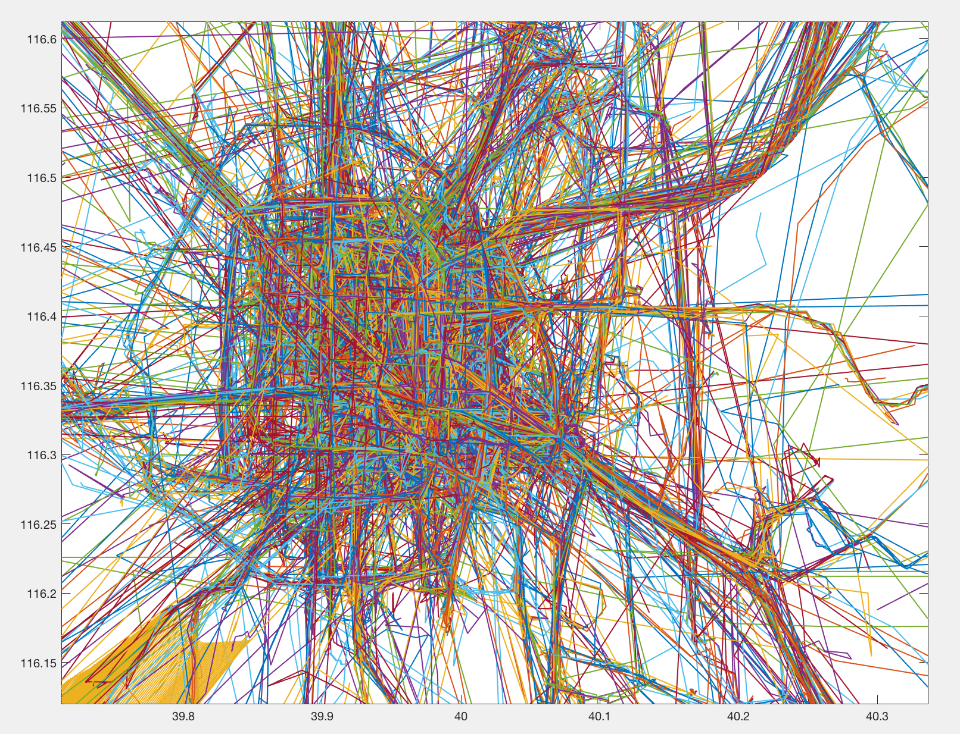
18670 People trajectories – Zoom 1

Slide 12
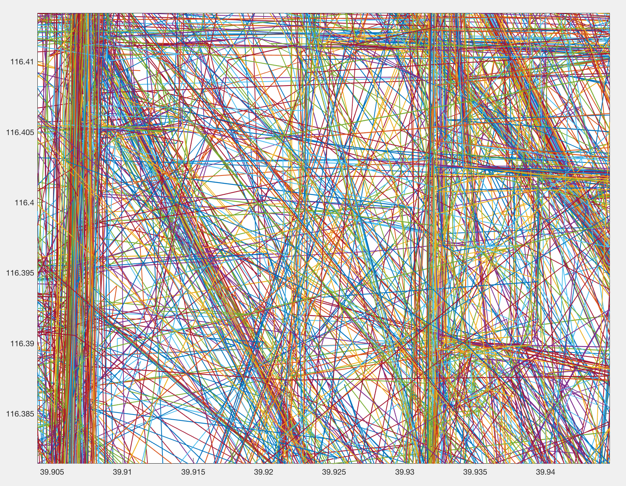
18670 People trajectories – Zoom 2

Slide 13
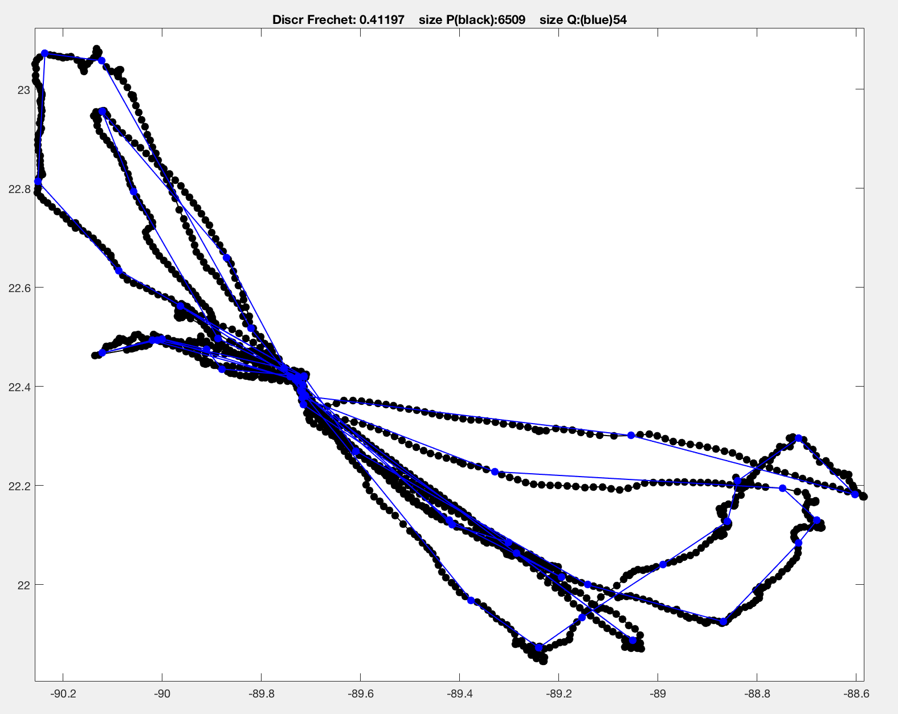
Bird curve – 6509 vertices

Slide 14
Sample Dive

Slide 15
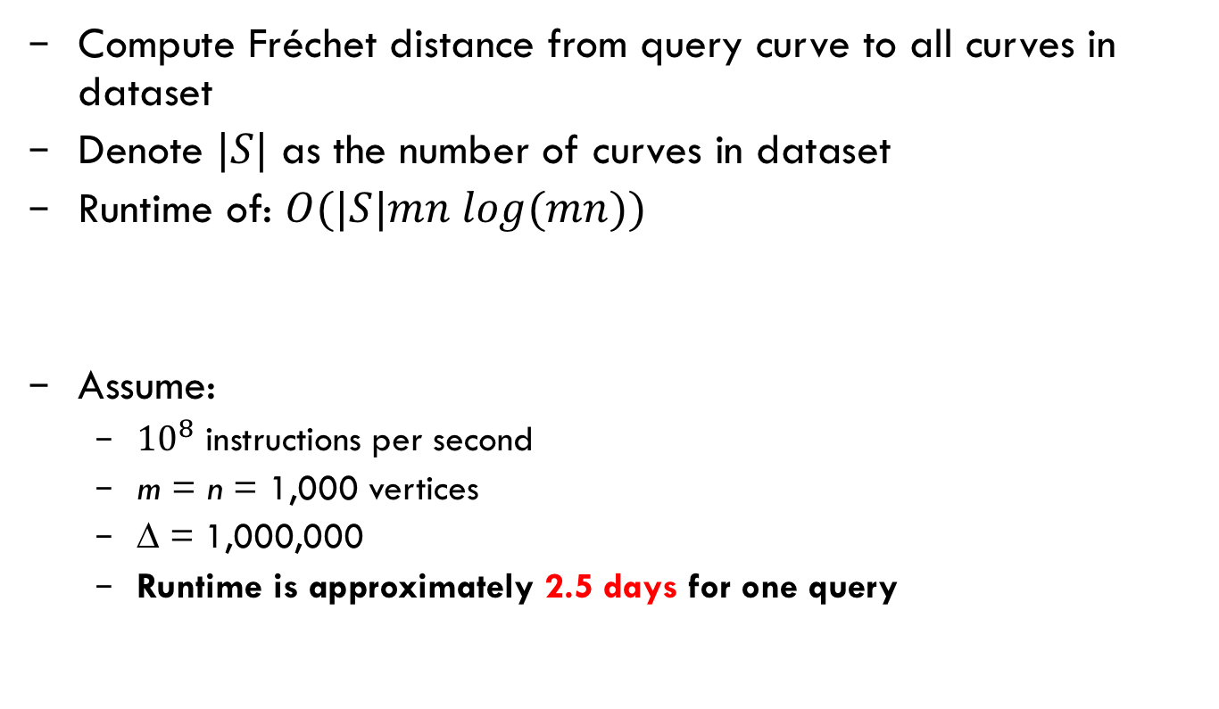
Naïve Exact NN/kNN/RNN Query Method
Compute Fréchet distance from query curve to all curves in dataset
Denote $|S|$ as the number of curves in dataset
Runtime of: $Ο(|S|mn log(mn))$
Assume:
${10}^{8}$ instructions per second
m = n = 1,000 vertices
∆ = 1,000,000
Runtime is approximately 2.5 days for one query

Slide 16


Our Contribution
1. Prune
Candidate Curves
Cluster Centre Tree
Candidate
Cluster
Centres
Cluster Centre Stamp
Bounds
2. Convert
CFD
FDP
3. Search
Final Results

Slide 17
Our Contribution – Measure Performance
Data Structure build:
Number of CFD and FDP computations
Queries:
Pruning: number cluster centre tree nodes accessed
Approximation: size of candidate curves and candidate cluster centres
Number of CFD and FDP computations

Slide 18
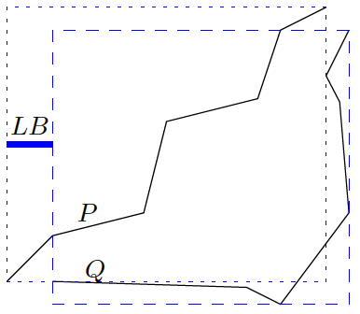
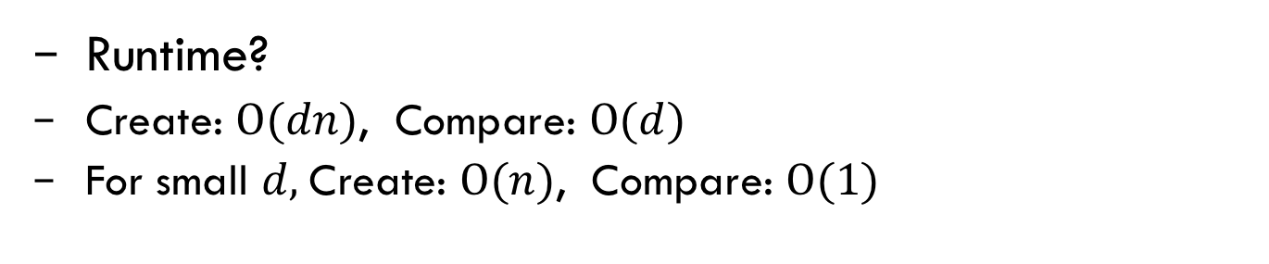
Bounds – Axis Aligned Bounding Box
Runtime?
Create: $Ο(dn)$, Compare: $Ο(d)$
For small $d,$Create: $Ο(n)$, Compare: $Ο(1)$

Slide 19
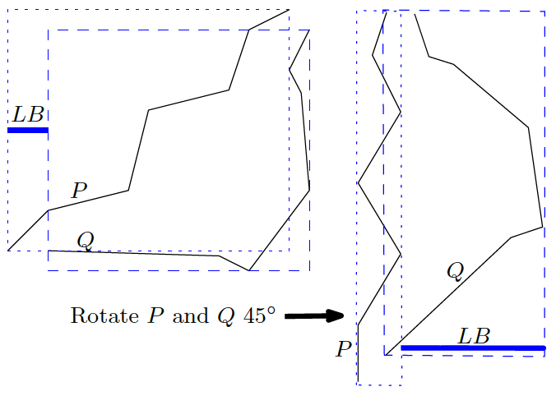
Bounds – Rotate Curves from origin

Slide 20

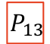
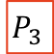

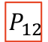
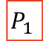



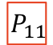

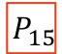
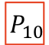



Cluster Centre Tree - Build
$$P_{7}$$
$$P_{12}$$
$$P_{5}$$
$$P_{6}$$
$$P_{8}$$
$$P_{9}$$
$$P_{10}$$
$$P_{11}$$
$$P_{13}$$
$$P_{14}$$
$$P_{15}$$
$$P_{n}$$
$$P_{1}$$
$$P_{2}$$
$$P_{3}$$
$$P_{4}$$

Slide 21



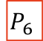







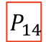


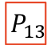
NN Pruning
Greedy, recursive dive into Cluster Centre Tree
Keeps track of the current best (smallest) upper/lower bounds
Gets better and better at pruning (eliminating nodes)
Keeps list of candidate curves
$$P_{7}$$
$$P_{12}$$
$$P_{5}$$
$$P_{6}$$
$$P_{8}$$
$$P_{9}$$
$$P_{10}$$
$$P_{11}$$
$$P_{13}$$
$$P_{14}$$
$$P_{15}$$
$$P_{n}$$
$$P_{1}$$
$$P_{2}$$
$$P_{3}$$
$$P_{4}$$

Slide 22
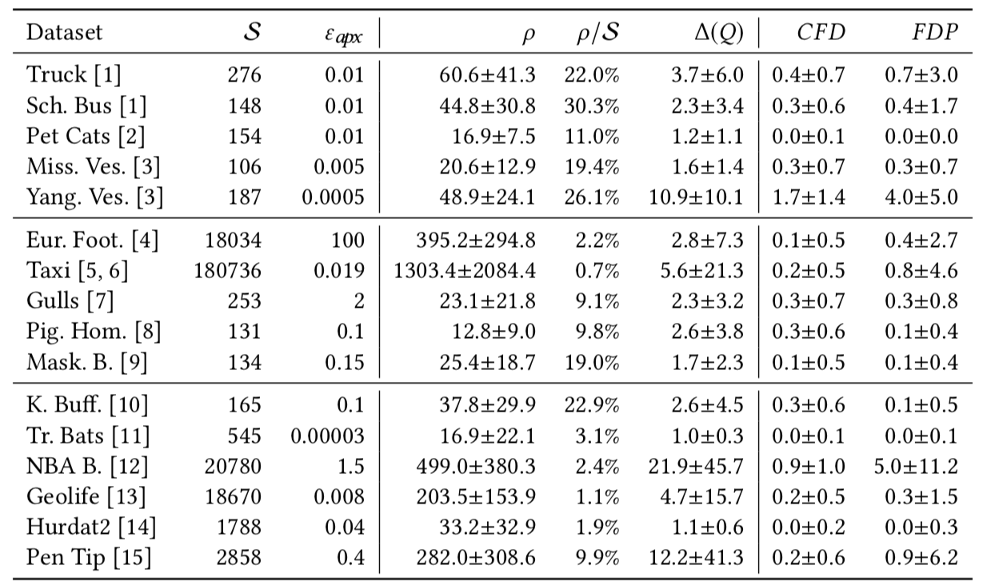
Results – NN using Cluster Centre Tree

Slide 23
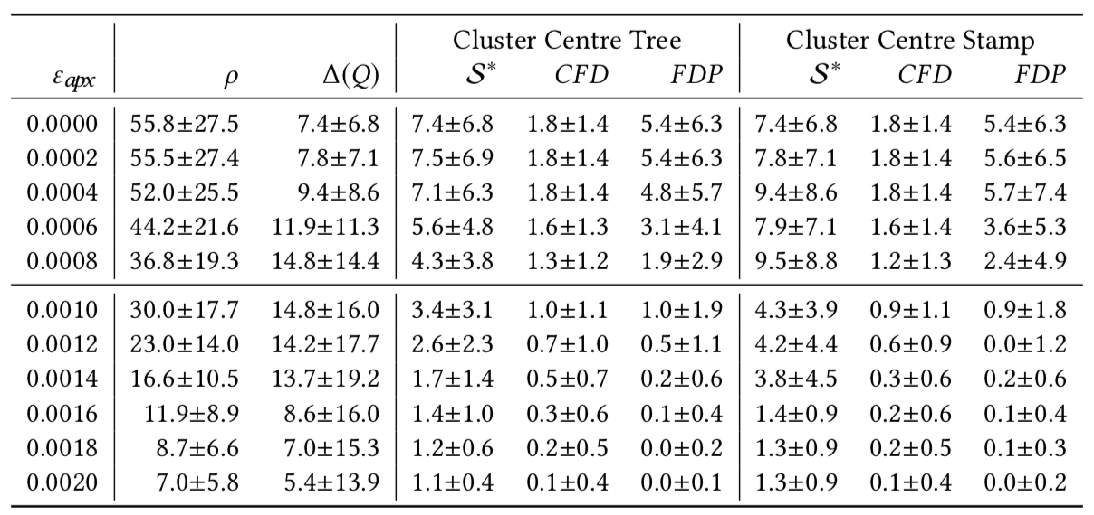

Results - NN query vary ${\text{ε}}_{apx}$ Yangtze Vessel dataset

Slide 24
Our Solution has some Drawbacks
Does not support sub-trajectory queries
Approximation threshold is ineffective if relatively small
Tree is relatively deep for the Taxi and Geolife datasets

Slide 25
New Questions
Are there solutions to some of the drawbacks?
Is it possible to dynamically insert/delete curves in the cluster data structures? Query performance impact?
Are there better cluster techniques that result in faster queries?

Slide 26
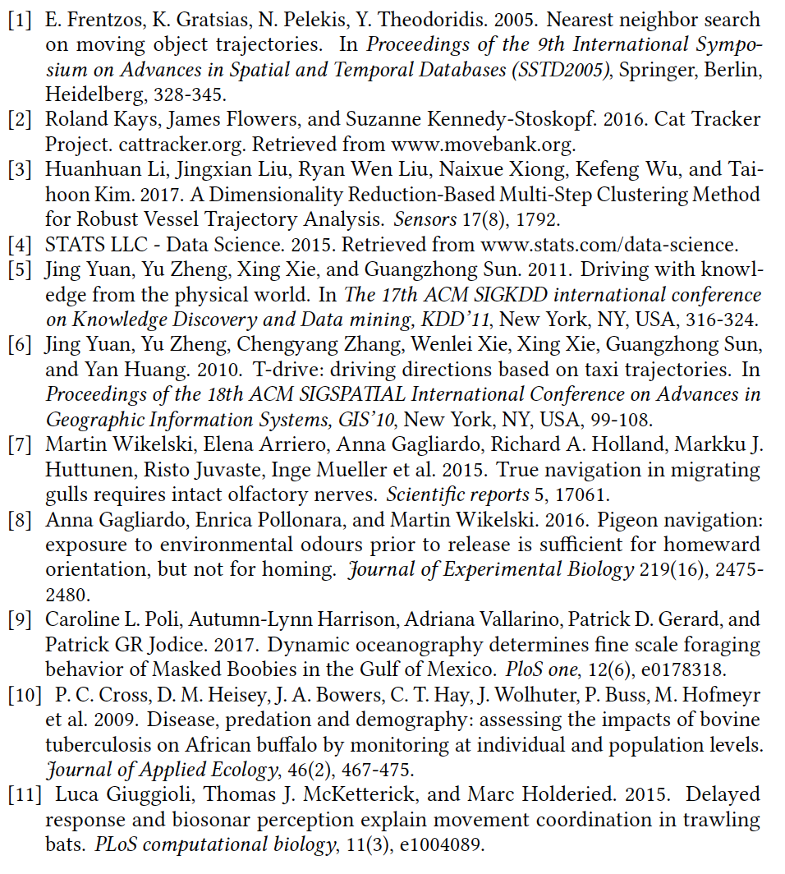
Thanks!

Slide 27
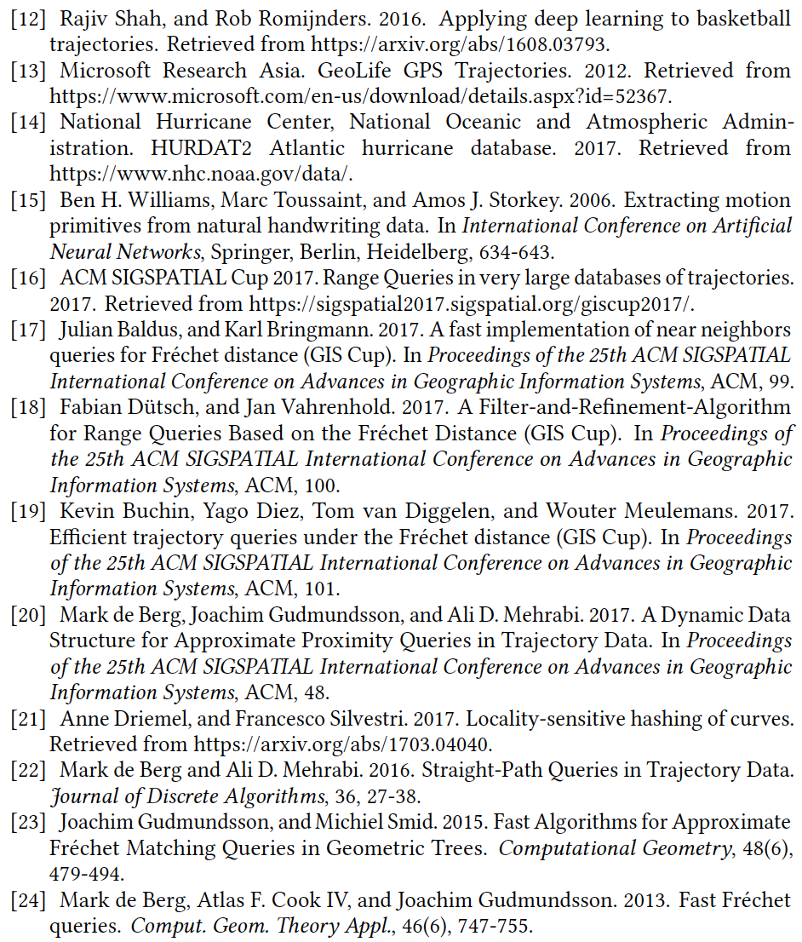
Thanks!

Slide 28
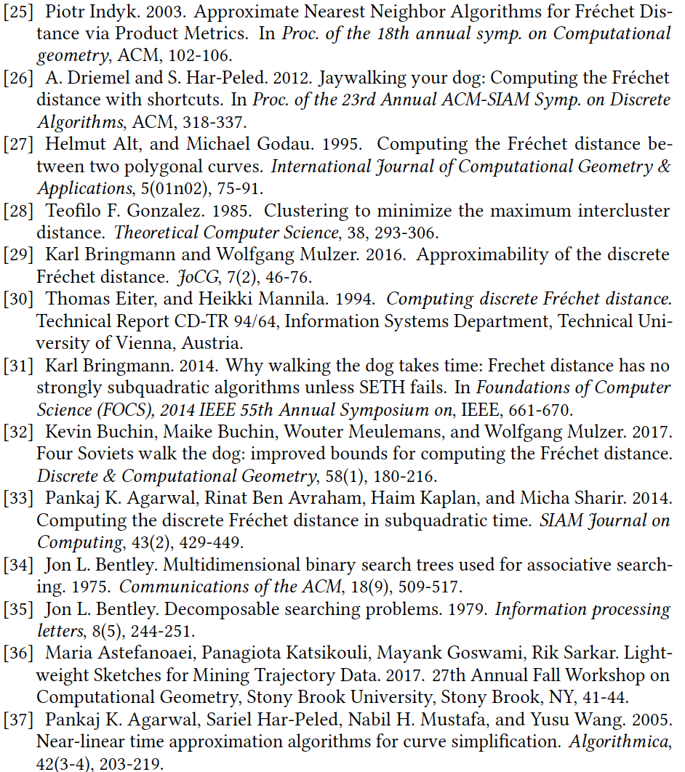
Thanks!

